Slide 1
EMPLOYEE ATTRITION PREDICTION OF HR
CREATED BY : AVNITA .MANU.PATEL

Slide 2
PROBLEM STATMENT
Employee attrition causes high costs and productivity loss.
Organizations need data-driven insights to predict and reduce attrition.

Slide 3
OBJECTIVE
- Predict employee attrition using machine learning
- Help HR teams take proactive retention actions
- Build an end-to-end ML project with deployment

Slide 4
Tools & Technologies
- Python
- Pandas, NumPy
- Scikit-learn
- Random Forest Classifier
- Streamlit
- Joblib
- VS Code

Slide 5
Dataset Description
- HR Employee Attrition dataset
- Features: Age, Department, Job Role, Salary, Overtime, etc.
- Target variable: Attrition (0 = No, 1 = Yes)

Slide 6
Methodology
1. Data Loading & Cleaning
2. Encoding categorical features
3. Train-test split
4. Model training using Random Forest
5. Model evaluation
6. Model deployment using Streamlit

Slide 7
Machine Learning Model
- Algorithm: Random Forest Classifier
- Handles non-linear data
- Reduces overfitting using ensemble learning

Slide 8
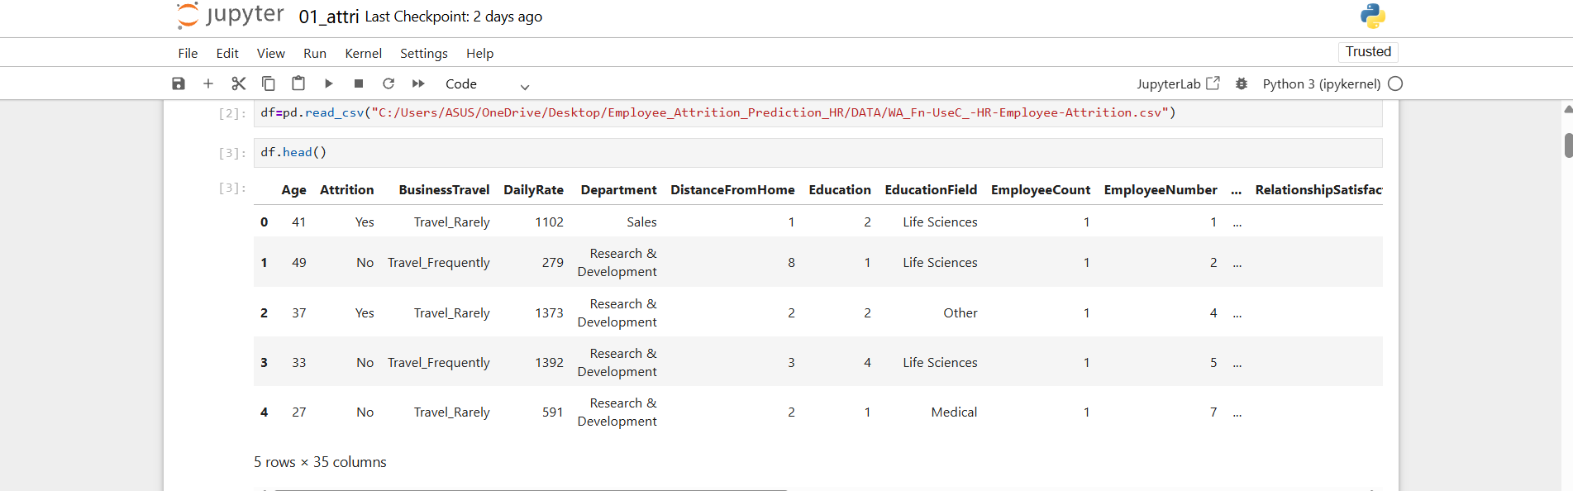
Output Screenshots

Slide 9
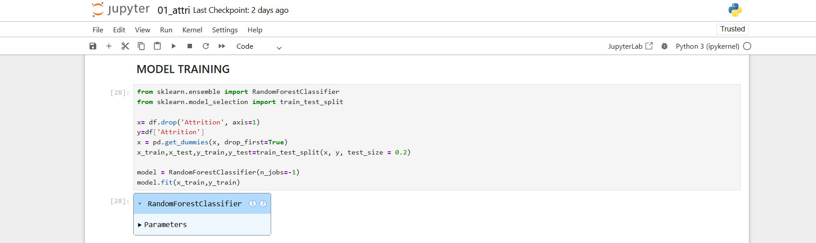
OUTPUT SCREENSHOT

Slide 10
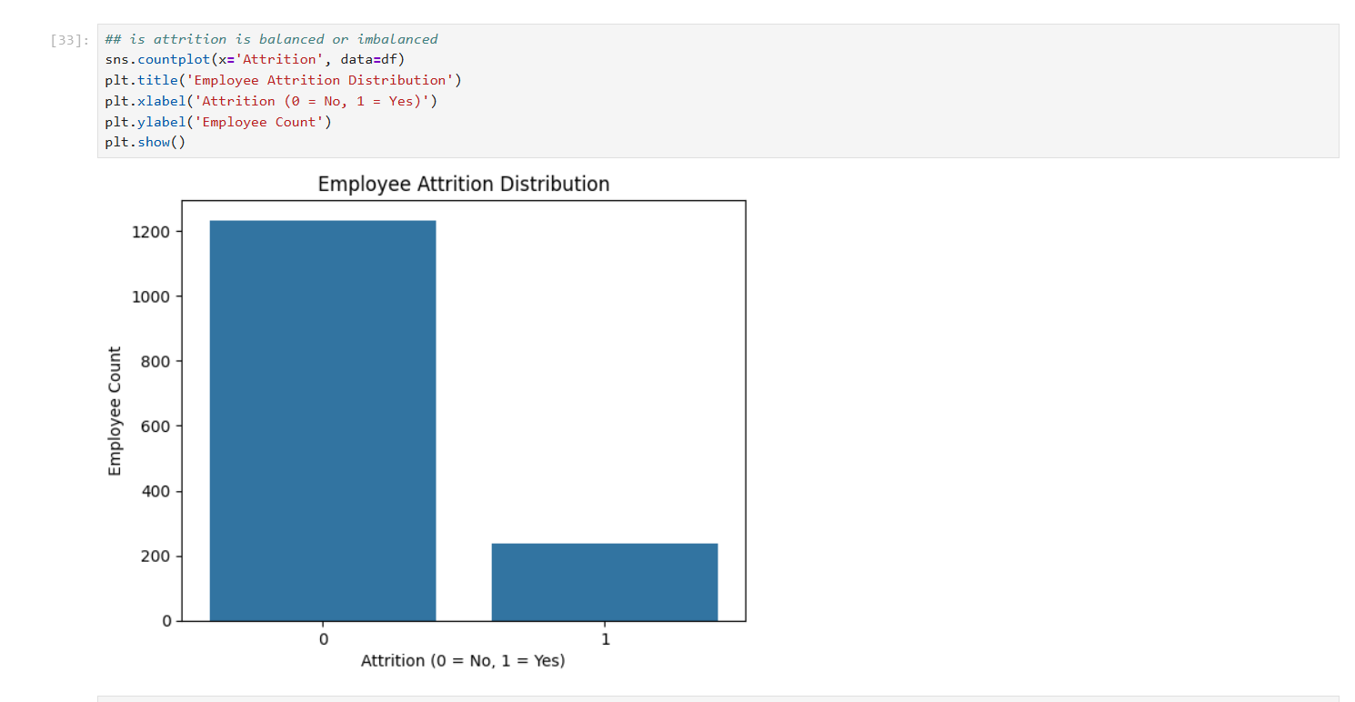
OUTPUT SCREENSHOTS

Slide 11
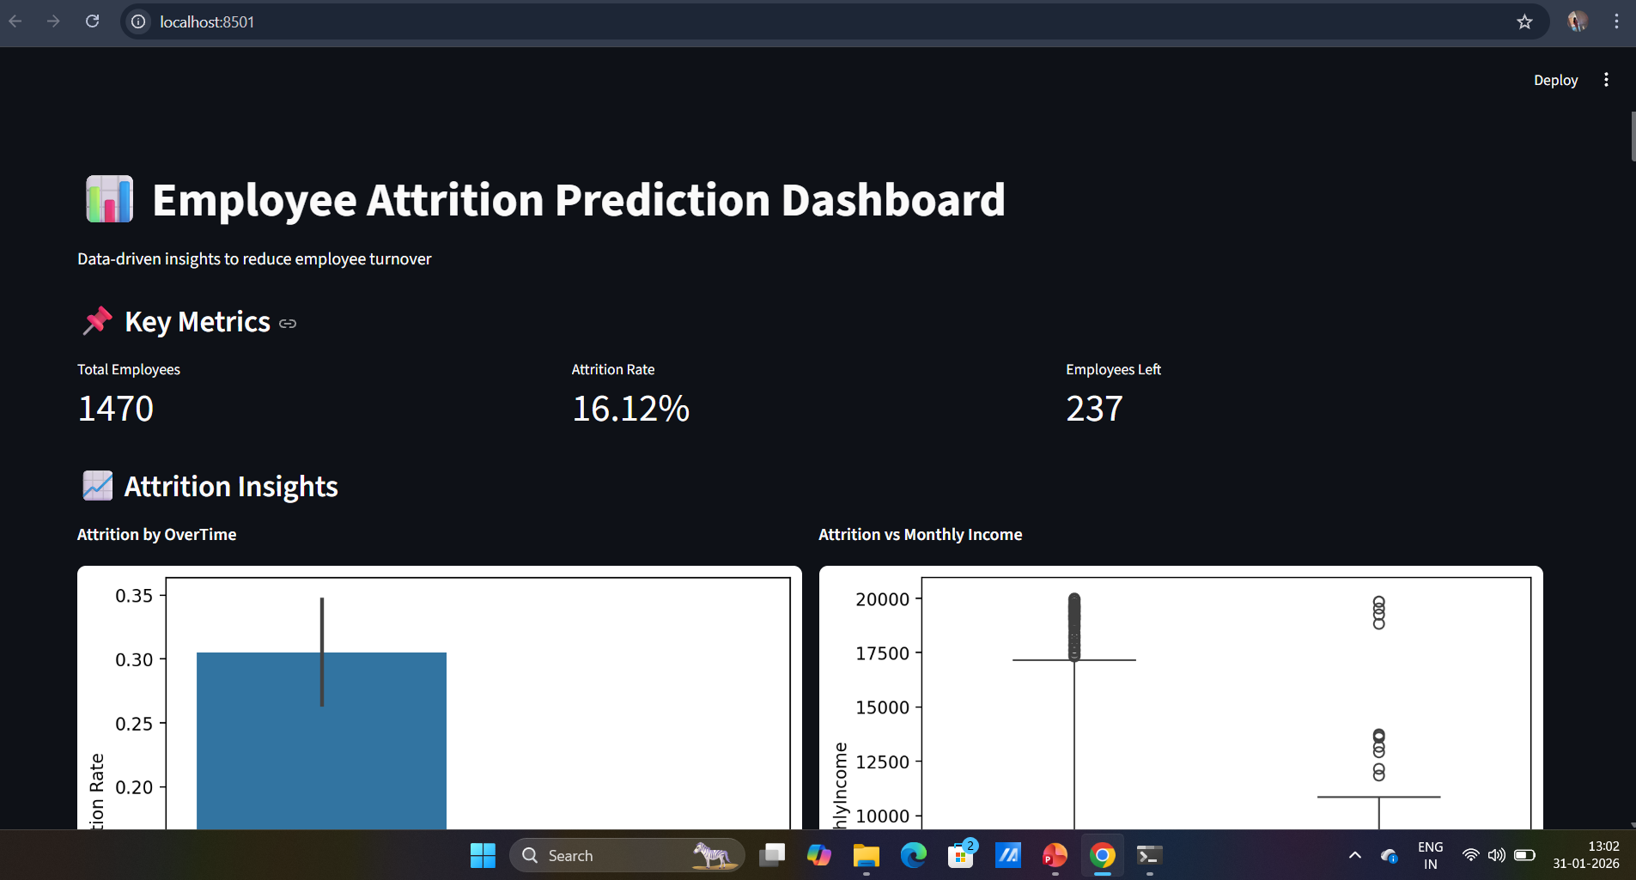
OUTPUT SCREENSHOTS

Slide 12
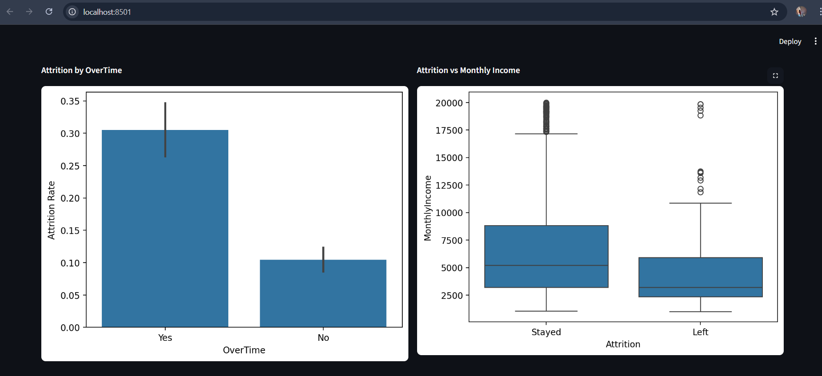
OUTPUT SCREENSHOTS

Slide 13
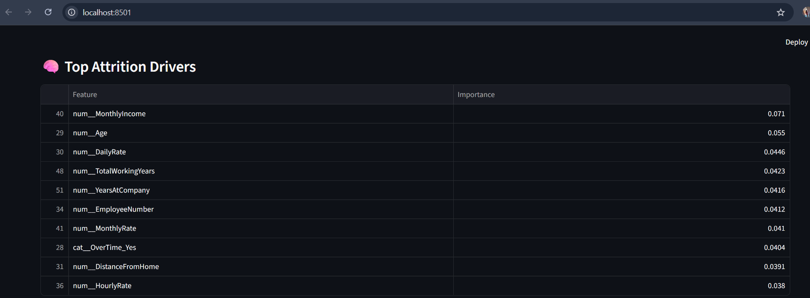
OUTPUT SCREENSHOTS

Slide 14
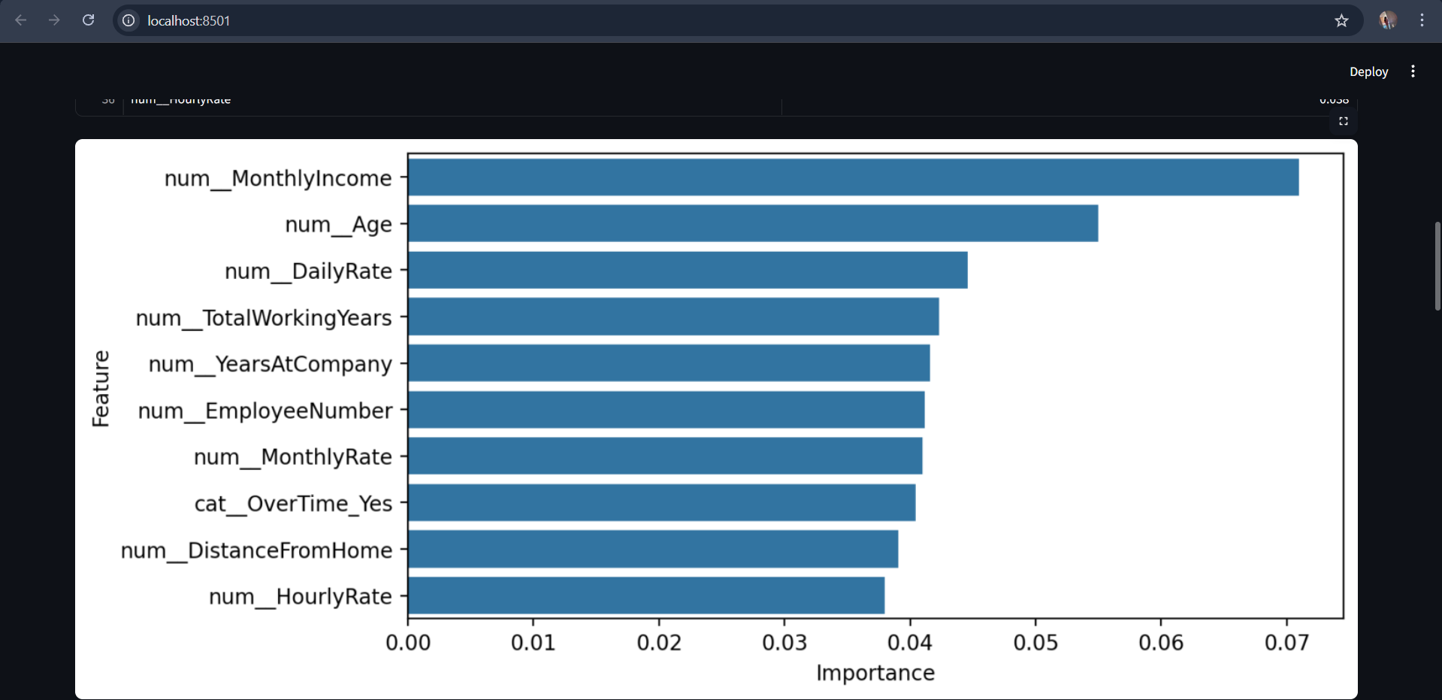
OUTPUT SCREENSHOTS

Slide 15
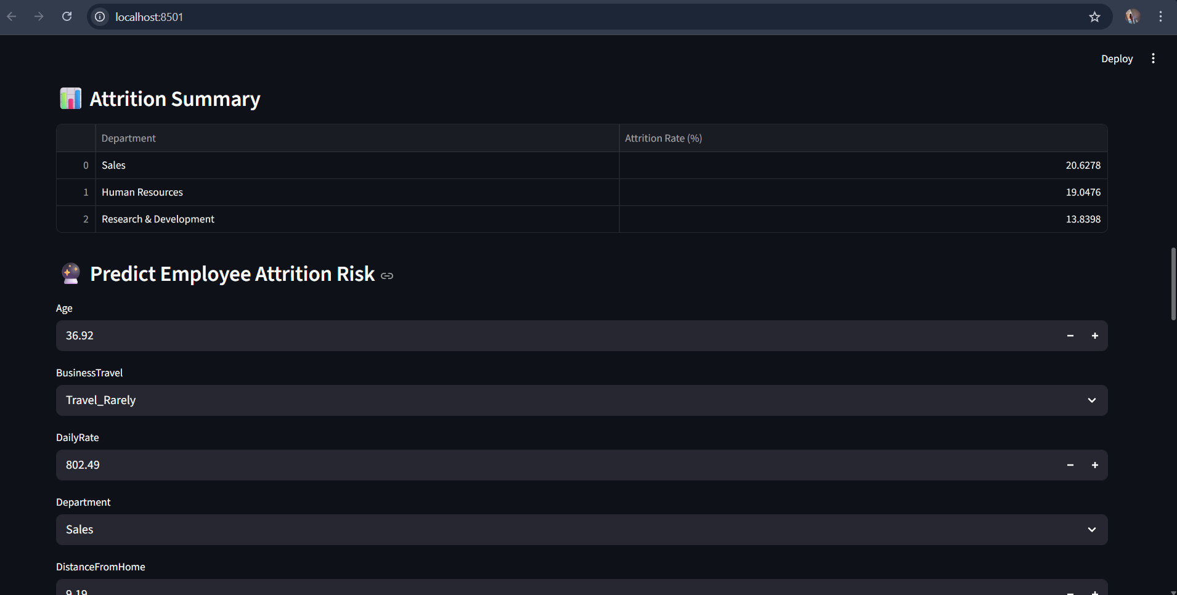
OUTPUT SCREENSHOTS

Slide 16
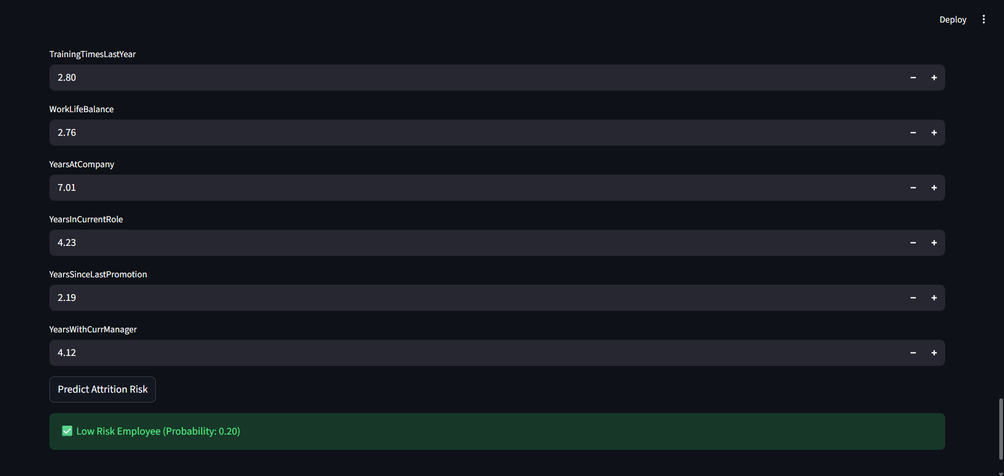
OUTPUT SCREENSHOTS

Slide 17
Conclusion
- Successfully built an end-to-end ML project
- Accurate attrition prediction
- Can be extended with more features and models

Slide 18
THANK YOU

